Slide 1

Introduction to R with a tidy mindset
Zachary Radford

Slide 2
What you’ll learn
What is R and why use it?
What is the tidyverse framework?
Get comfortable with R Studio
R basics (loading packages, data, etc.)
Data manipulation and visualisation
Living the dream!

Slide 3

What is R and why use it

Slide 4

What is R and why use it?
Programming language designed for data science & statistics
Excellent data handling, storage, manipulation and analysis facilities
Repeatable analysis
Open source!

Slide 5
What is tidyverse?

Slide 6
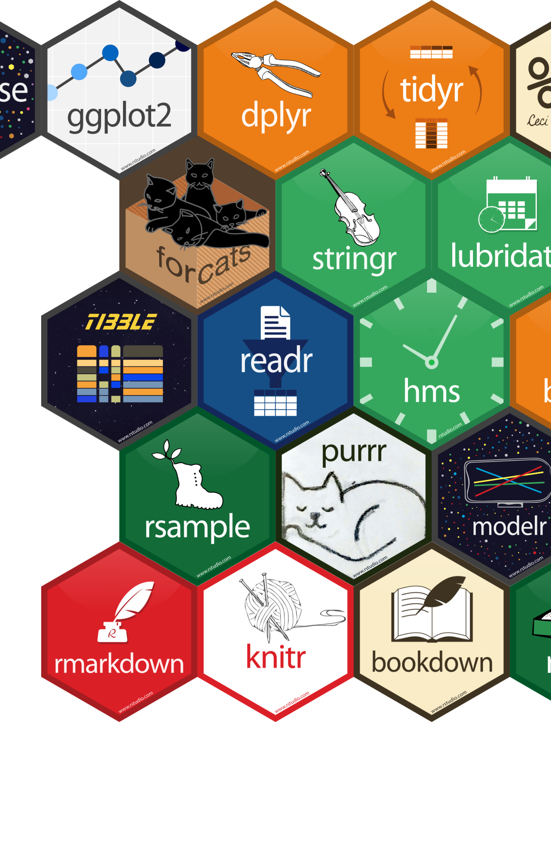
What is tidyverse?
Million different ways to do things in R
Collection of R packages
Underlying design philosophy, grammar, and data structures
Increased code readability & repeatability

Slide 7
Getting comfortable with R studio

Slide 8
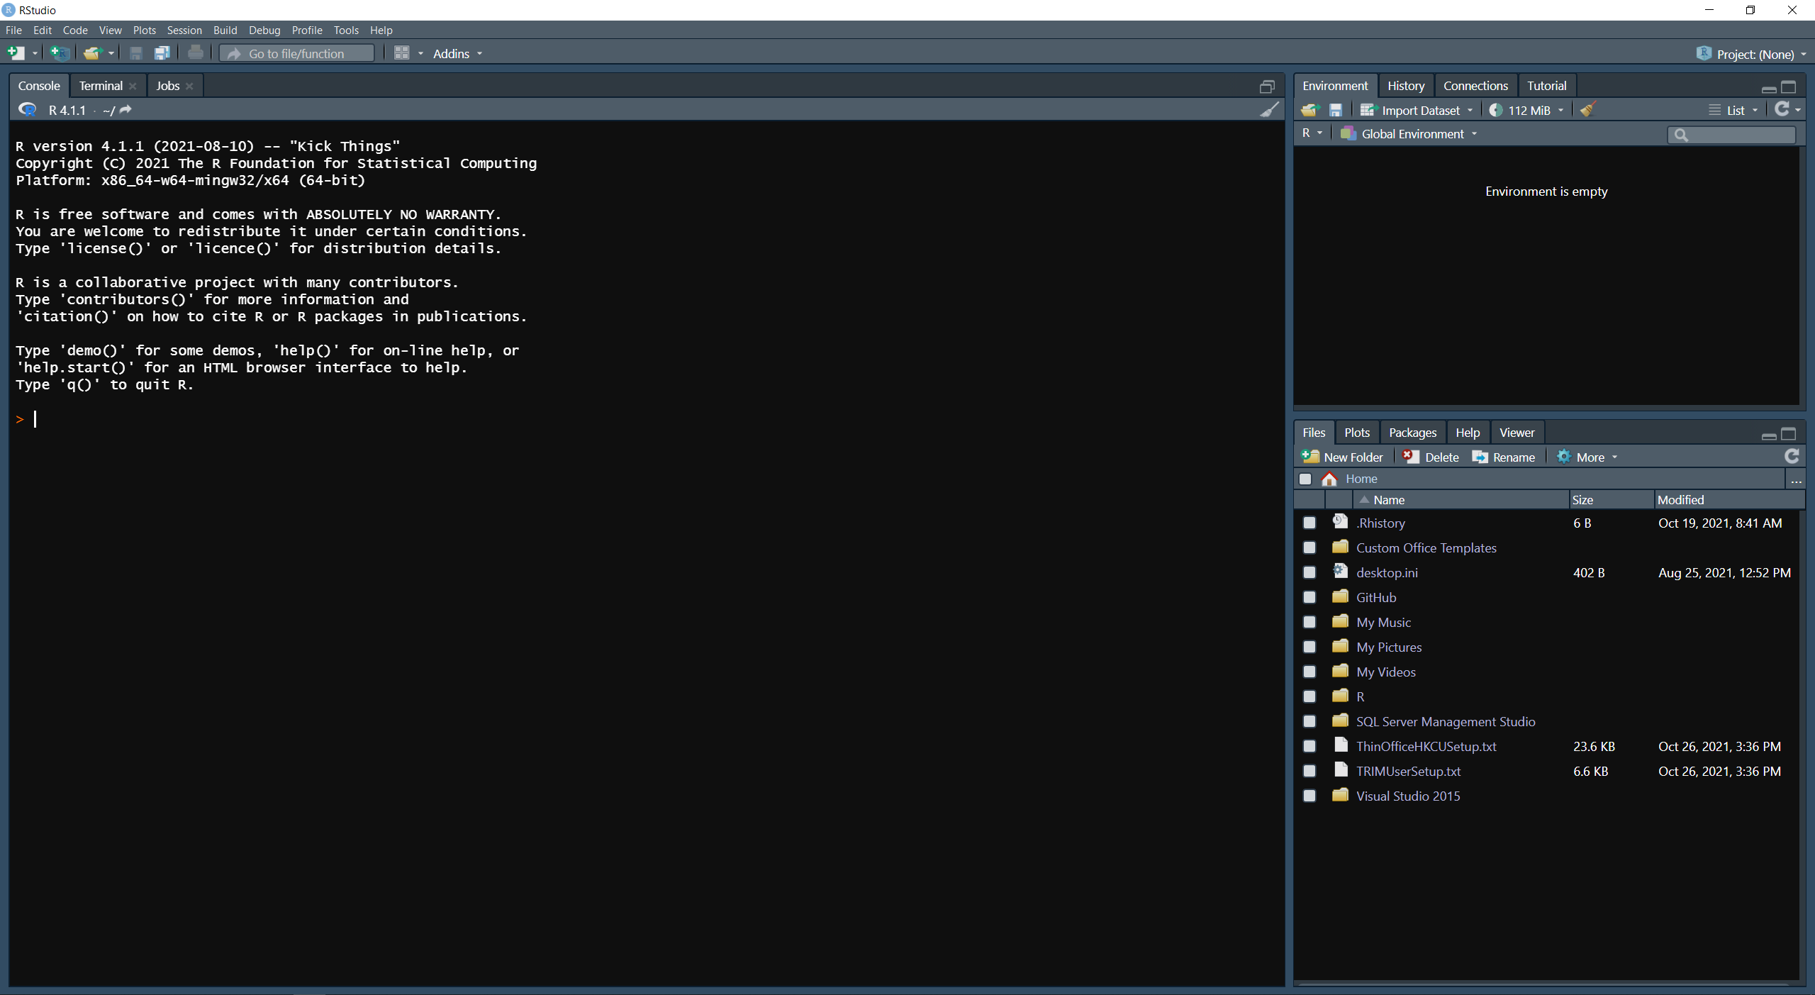

Slide 9
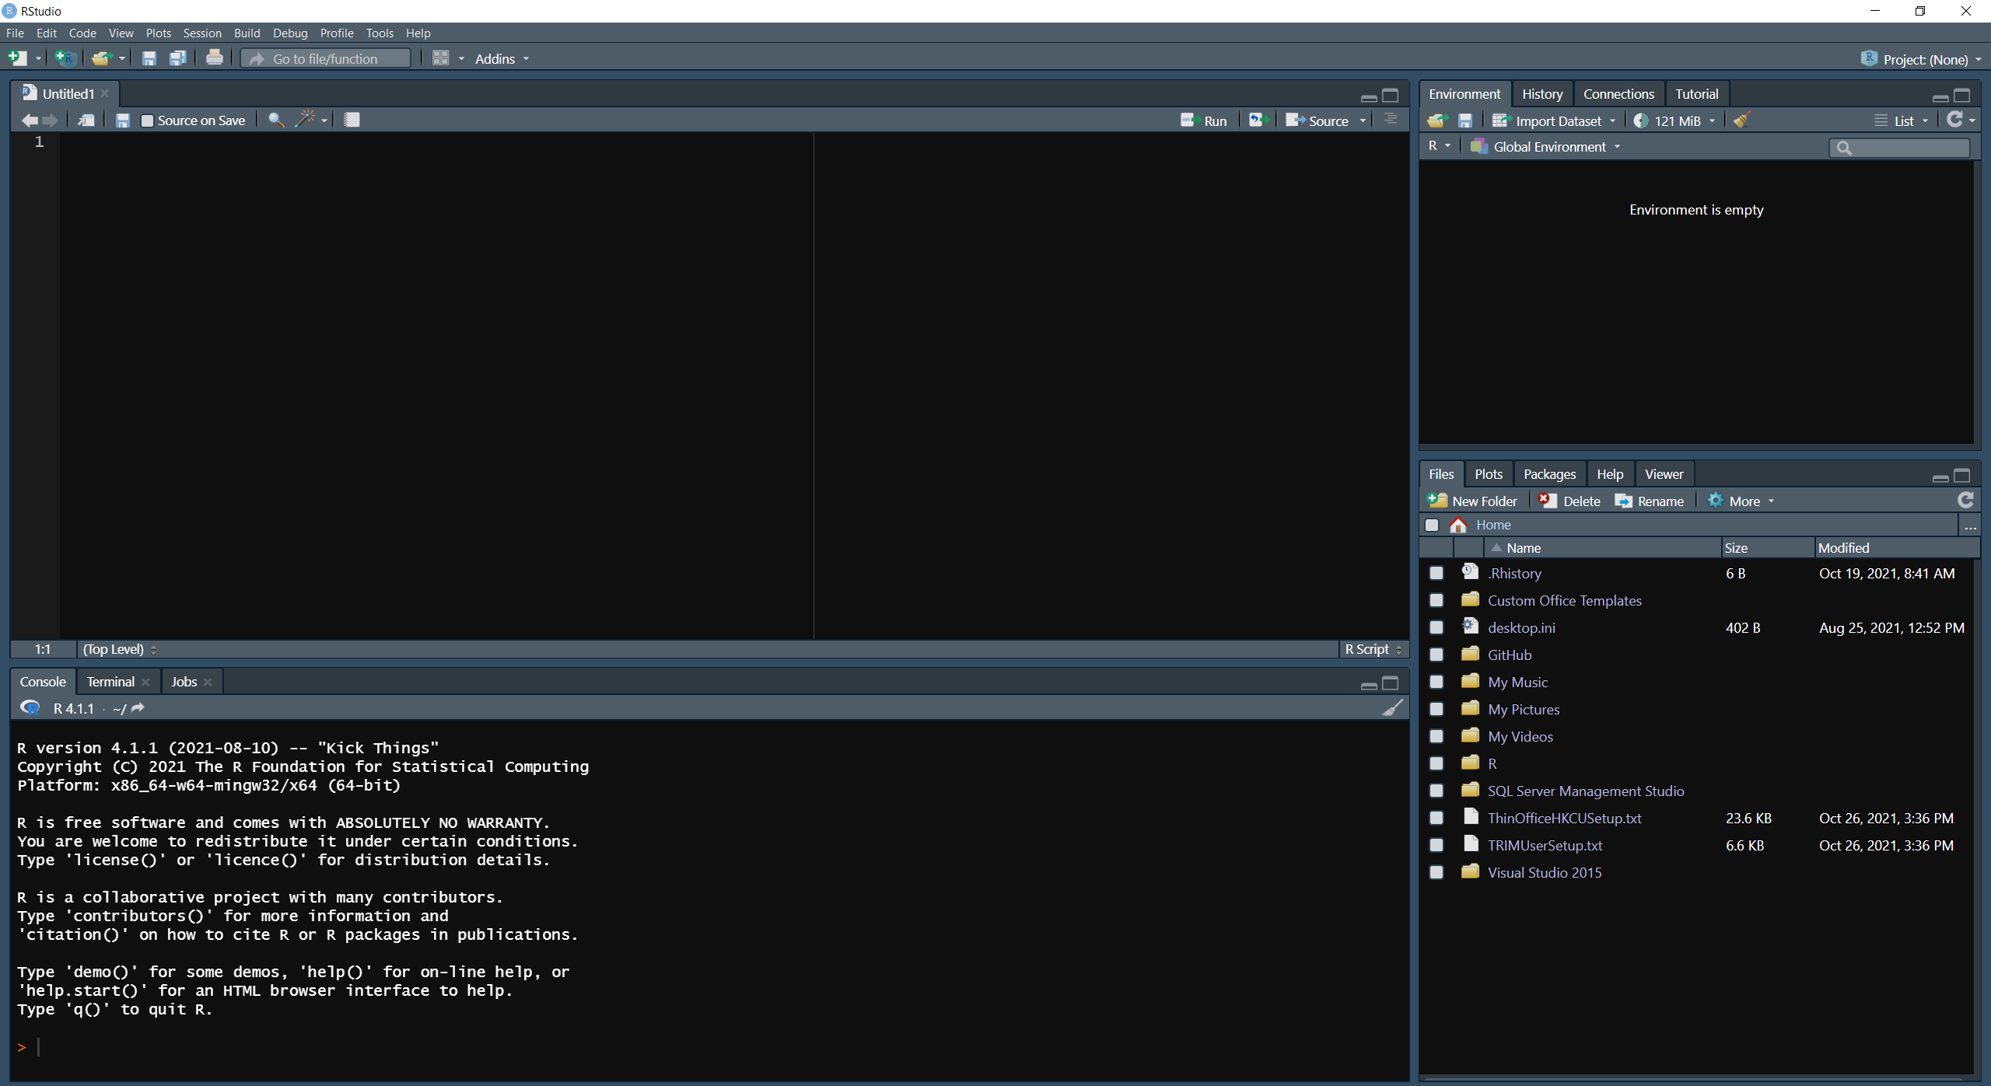
Notes:
First, we have the script window
Spend most time here
Where you actually write and run your reproduceable code!
2nd is your r console
Predominantly used when testing things
e.g. when writing a script you might want to look at a dataset but don’t want this to be in the final script
Can just run type the command in here to do this
Will also be where many of your outputs are printed out
3rd is your R environment
List of all the things you’ve created!
Can do things like importing data, removing objects, etc. here but not usually good practice to do this
4th is your file browser
Can help you quickly find where you saved your data, removing things you’ve saved accidentally or renaming it
Finally is your list of R projects
Projects are amazing and will be used a lot in this course
Rather than having to get and set WD’s, having to clear your R environment when working on a new project this is all done automatically by R studio

Slide 10
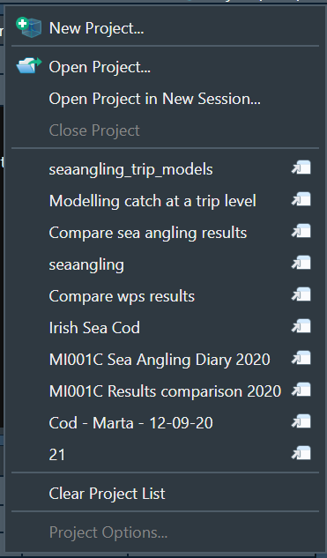
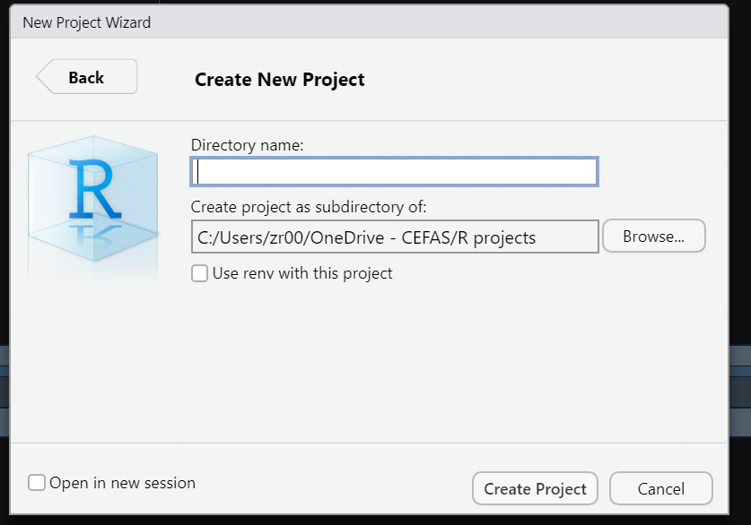
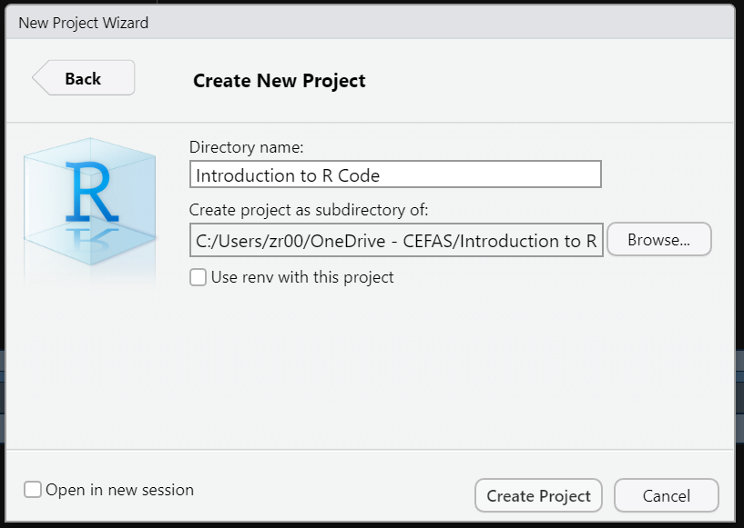
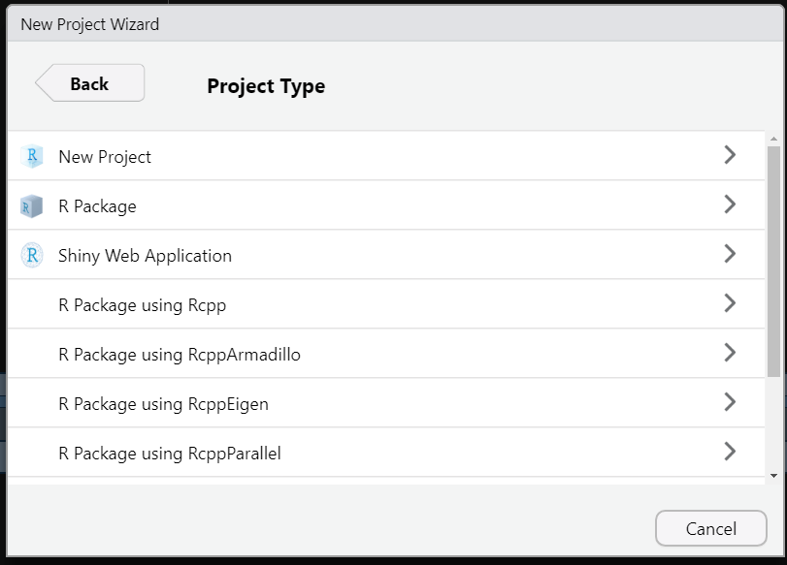
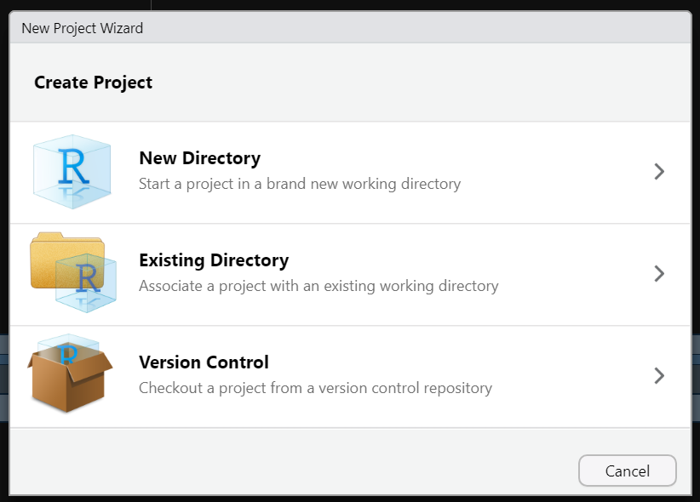

Slide 12
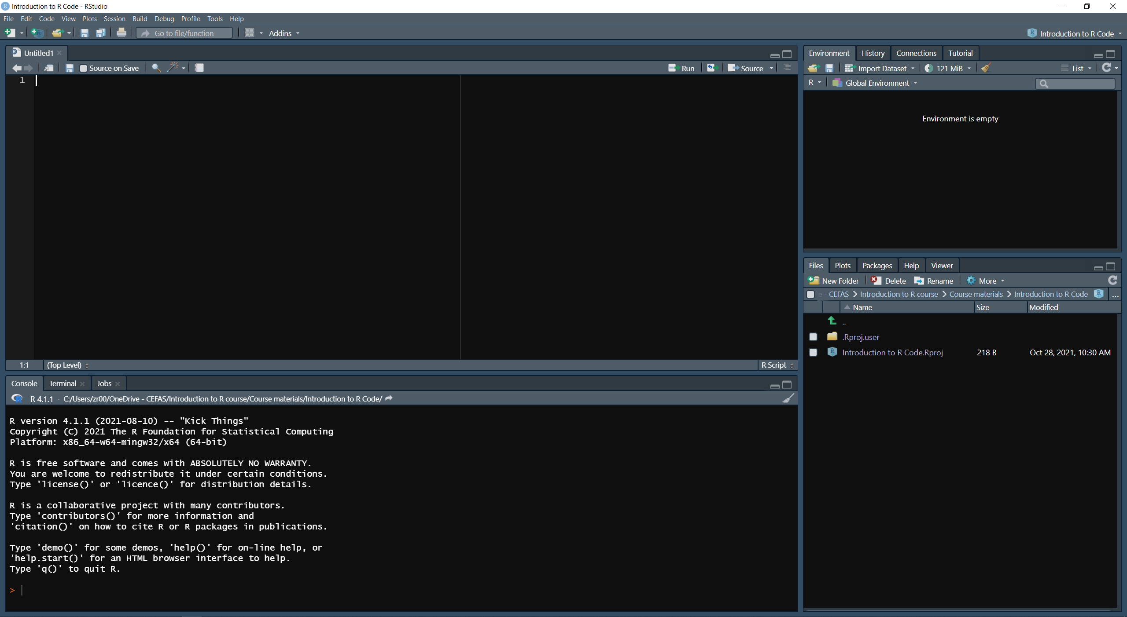
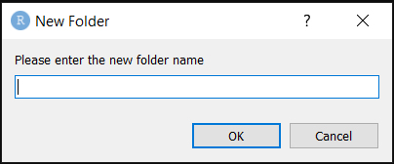
Code
Input
Output

Slide 13
Switch to RStudio

